Slide 1
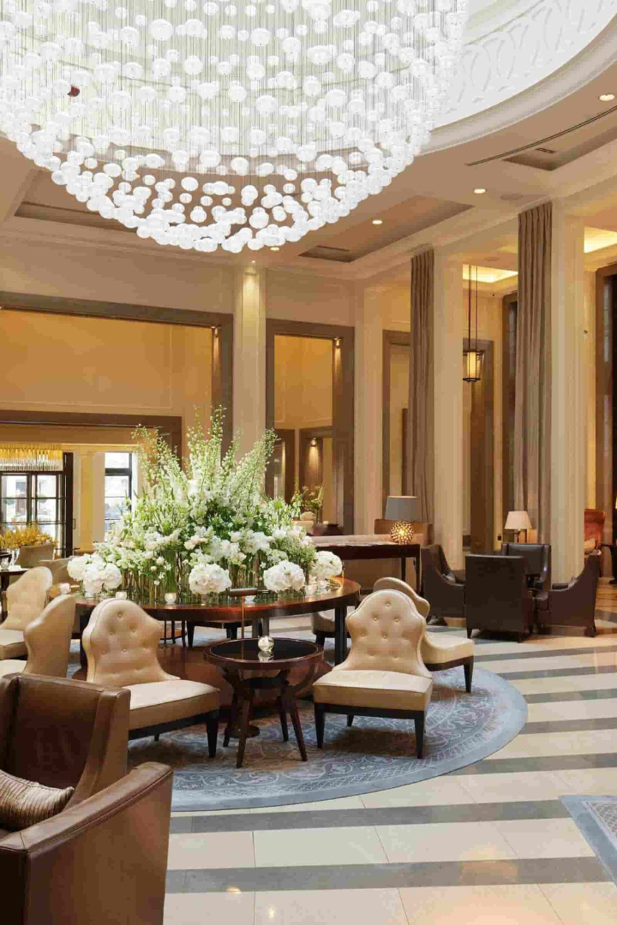
Hotel Management System
Welcome to our presentation on the Hotel Management System. Discover how our system can streamline your hotel's operations and enhance guest experiences.

Slide 2

Problem Statement
Explore the challenges faced by hotel managers, from manual reservation processes to inefficient customer service and the need for a comprehensive hotel management system.

Slide 3
Goals of the Project
it includes automating reservation and check-in/check-out processes, and providing seamless guest communication.

Slide 4
Features and Functionalities
Reservation Management
Management part
Effortlessly handle guest reservations, room availability to ensuring a smooth and efficient process.
This helps us to control the various aspect of the hotel by accessing the management part of the system.
Billing
Housekeeping and Maintenance
tracking the time table of reservation and automate billing processes that will generate comprehensive financial reports for better financial control.
Schedule and track housekeeping tasks, monitor maintenance requests, and ensure a clean and comfortable environment for guests.

Slide 5
Technical Implementation Details
Languages used
C++

Slide 6

Overview of the Hotel Management System
Get an overview of our user-friendly interface, intuitive features, and how the system integrates various hotel operations, including front desk, housekeeping and more.

Slide 7
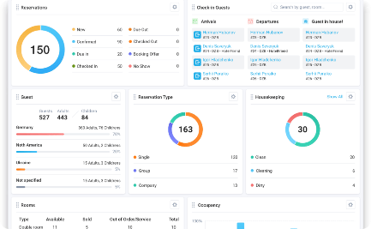
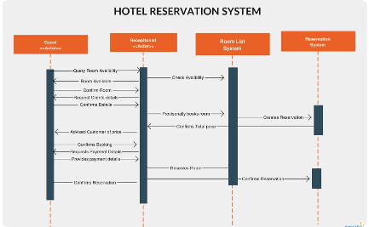

Demo of the Hotel Management System
Dashboard
Reservation Process
Customer Support
Experience the power of our intuitive dashboard, providing real-time insights, analytics, and quick access to essential functions.
Witness the seamless reservation process, from guest inquiry to reservation confirmation, with multiple payment options.
Explore the easy way’s for the customers to get maximum satsfaacftion with limited time.

Slide 8

Next Steps and Conclusion
Summarize the benefits of implementing the Hotel Management System and provide an overview of the next steps for incorporating the system into your hotel operations.

